Slide 1
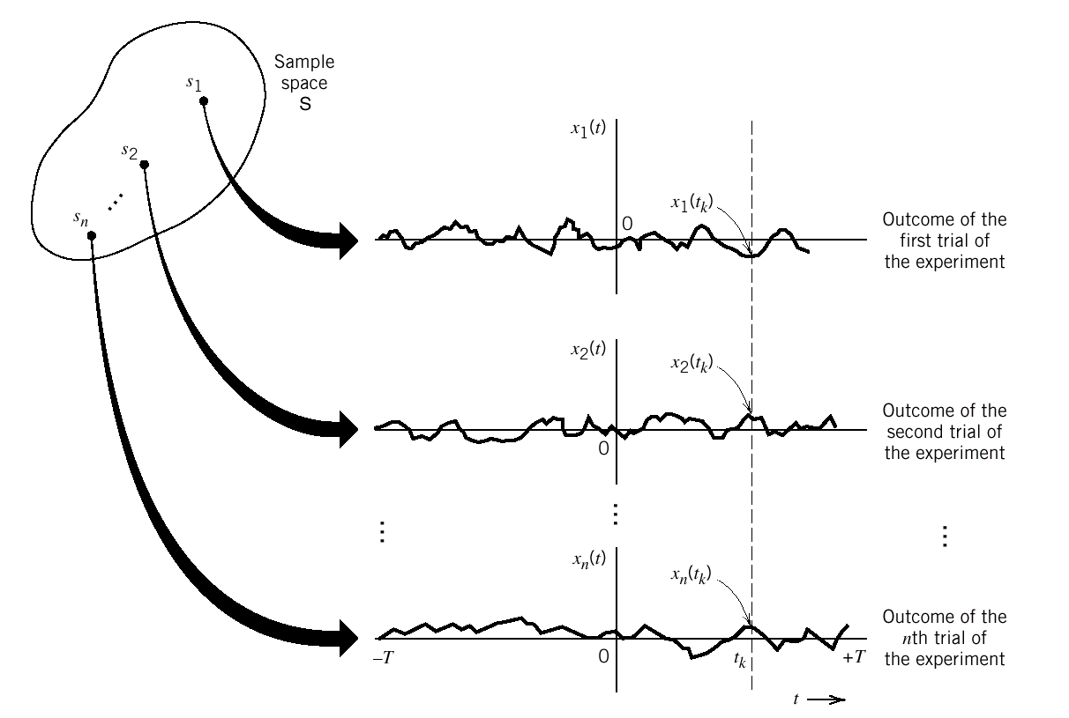
Random Processes
A random process is a set of indexed random variables (sample functions) defined in the same probability space.
In communications, the index is usually in terms of time.
x_{i}(t) is called a sample function
of the sample space.
The set of all possible sample functions
{x_{i}(t)} is called ensemble and defines
the random process X(t).
For a specific i, x_{i}(t) is a time function.
For a specific t_{i}, X(t_{i}) denotes a random variable.

Slide 2
Random Processes: Properties
Consider a random process X(t) , let X(t_{k}) denote the random variable obtained by observing the process X(t) at time t_{k} .
Mean: m_{X}(t_{k}) =E{X(t_{k})}
Variance: σ_{X}² (t_{k}) =E{X²(t_{k})}-[m_{X} (t_{k})] ²
Autocorrelation: R_{X}{t_{k} ,t_{j}}=E{X(t_{k})X(t_{j})} for any t_{k} and t_{j}
Autocovariance: C_{X}{t_{k} ,t_{j}}=E{ [X(t_{k})- m_{X} (t_{k})][X(t_{j})- m_{X} (t_{j})] }

Slide 3
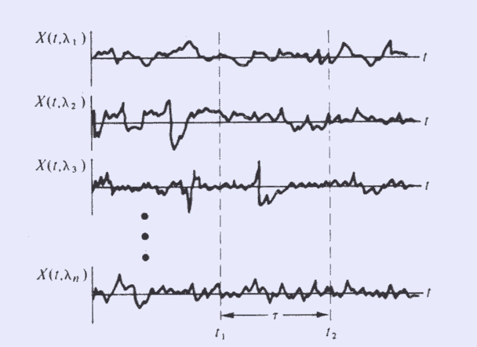
Ensemble Average and Time Average
Ensemble Average
The statistical average that is determined from the measurements
made at some fixed time t = t_{i} on all sample functions.
Time Average
The statistical average that is determined from the measurements
made on one sample function for a period of time.

Slide 4
Stationarity and Ergodicity
Stationary Random Process
Ensemble average (mean, variance) does not change with time (constant).
Correlation and covariance depend only on time difference.
Ergodic Random process
Ensemble average and time average are equal
The statistical properties can be determined from one sample function in the ensemble
An ergodic random process is stationary but a stationary random process is not necessarily ergodic.

Slide 5
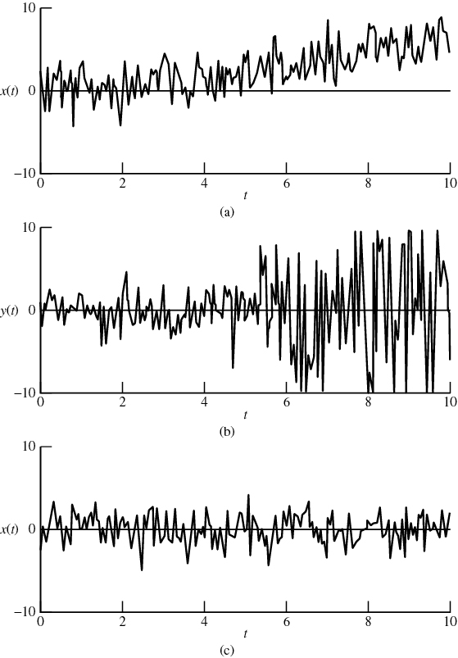
Stationary Random Process
Time varying mean
Time varying variance
Stationary

Slide 6


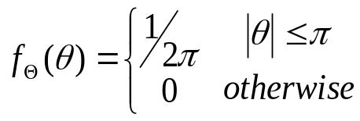
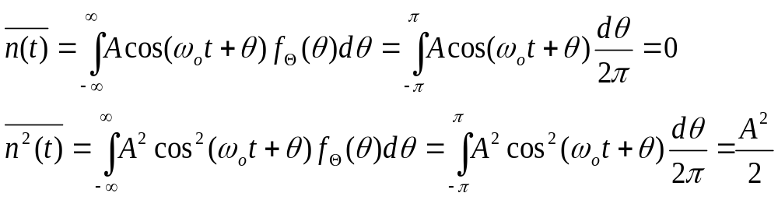
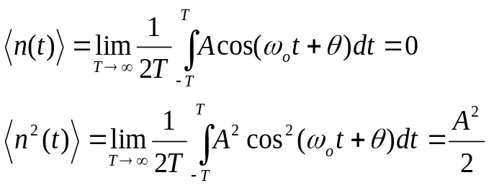
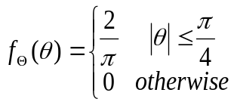
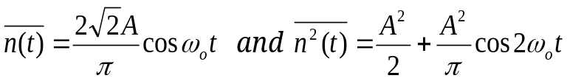
Stationarity and Ergodicity: Example
Consider the random process with sample function
where ω_{o} is constant and is a random variable with pdf
Compute statistical ensemble averages:
i.e. mean =0
i.e. variance=A²/2
Compute time averages:
i.e. mean =0
i.e. variance=A²/2
As ensemble average = time average, the random process is ergodic.
If
then
Time dependent ! ⇒ Not stationary !

Slide 7
Backup

Slide 8
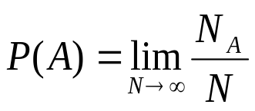
Probability and Random Variables
Concept of Probability:
When the outcome of an event is not always the same, probability is the measure of the chance of obtaining a particular possible outcome
Where N is total number of event occurrence,
N_{A} is the number of occurrence of outcome A
e.g. dice tossing: P{2} = 1/6 ; P{2 or 4 or 6} = 1/2
Notes:
gamble

Slide 9
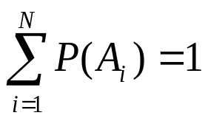
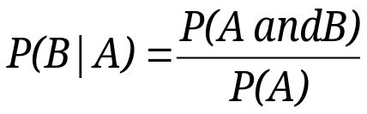
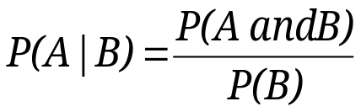
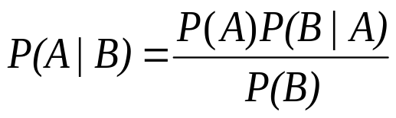
Common Properties of Probability
0≤ P(A) ≤ 1
If there are N possible outcomes {A₁ , A₂ , … , A_{N}} then
Conditional Probability:
probability of the outcome of an event is conditional on the outcome of another event
;
Bayes’ theorem

Slide 10
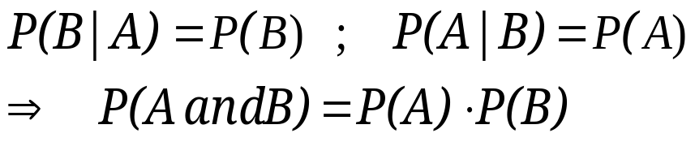

Common Properties of Probability
Mutually exclusiveness
P(A or B) = P(A) + P(B); P(A and B) = 0
Statistically Independence
Thus, A and B are mutually exclusive.
Thus, A and B are statistically independent.

Slide 11
Communication Example
In a communication channel, signal may be corrupted by noise.
m₀
P(r₀|m₀)
r₀
P(r₀|m₁)
P(r₁|m₀)
m₁
r₁
P(r₁|m₁)
If r₀ is received, m₀ should be chosen if
P(m₀|r₀)P(r₀) > P(m₁|r₀)P(r₀)
By Bayes’ theorem P(r₀|m₀)P(m₀) > P(r₀|m₁)P(m₁)
Similarly, if r₁ is received, m₁ should be chosen if
P(m₁|r₁)P(r₁) > P(m₀|r₁)P(r₁) ⇒ P(r₁|m₁)P(m₁) > P(r₁|m₀)P(m₀)
Probability of correct reception: P(c) = P(r_{o}|m_{o})P(m_{o}) + P(r₁|m₁)P(m₁)
Probability of error: P(ε) = 1-P(c)
Notes:
MAP=ML when m0 and m1 has equal probability.

Slide 12
Random Variables
A random variable X(.) is the rule or functional relationship which assigns real numbers X(λ_{i}) to each possible outcome λ_{i} in an experiment.
For example, in coin tossing, we can assign X(head) = 1, X(tail) = -1
If X(λ) assumes a finite number of distinct values
discrete random variable
If X(λ) assumes any values within an interval
→ continuous random variable

Slide 13





Cumulative Distribution Function
The cumulative distribution function, F_{X}(x) , associated with a random variable X is:
F_{X}(x)
1
Properties:
0
x
(Non-decreasing)
F_{X}(x)
1
0
x

Slide 14
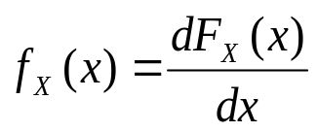

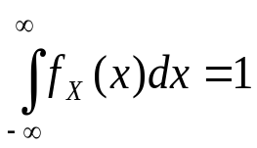
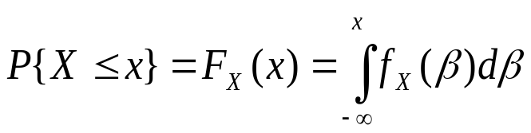
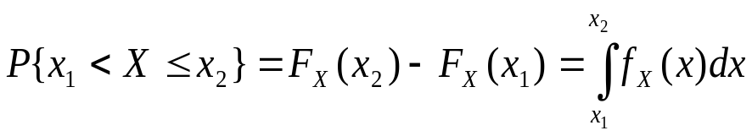
Probability Density Function
The probability density function, f_{X}(x) , associated with a random variable X is:
F_{X}(x)
Properties:
1
for all x
0
x
f_{X}(x)
0
x
Notes:
What is the values of the crossing points at y axis?

Slide 15
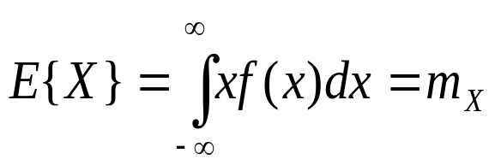
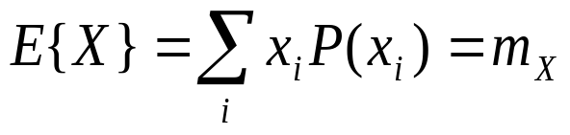
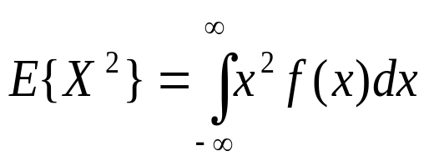
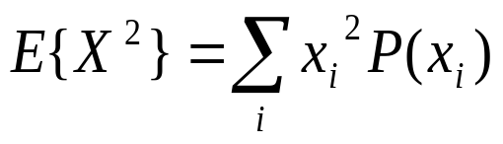
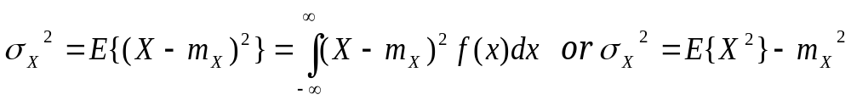
Statistical Averages of Random Variables
The statistical average or expected value of a random variable X is defined as
or
E{X} is called the first moment of X and m_{X} is the average or mean value of X.
Similarly, the second moment E{X²} is
or
Its square root is called the root-mean-square (rms) value of X.
The variance of the random variable X is defined as
The square root of the variance is called the standard deviation, σ_{X}, of the random variable X.

Slide 16
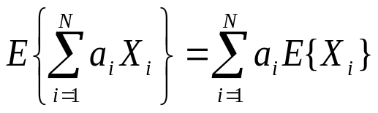
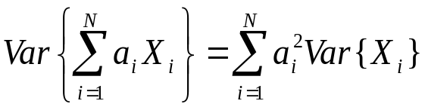
Statistical Averages of Random Variables
Expected value of linear combination of N random variables is equivalent to linear combination of expected values of individual random variables
For N statistically independent random variables: X₁, X₂, … , X_{N}
Covariance of a pair of random variables: X, Y
If X and Y are statistically independent, μ_{XY}=0

Slide 17
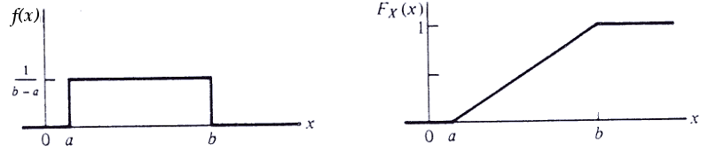
Uniform Distribution
A random variable that is equally likely to take on any value within a given range is said to be uniformly distributed.

Slide 18
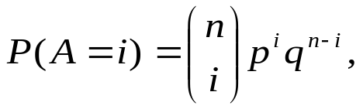
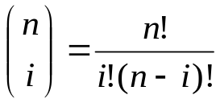
Binomial Distribution
Consider an experiment having only two possible outcomes, A and B, which are mutually exclusive.
Let the probabilities be P(A) = p and P(B) = 1 − p = q.
The experiment is repeated n times and the probability of A occurring i times is
where
(binomial coefficient).
The mean value of the binomial distribution is np and the variance is (npq).
Notes:
Black or white，sunny or rainy

Slide 19
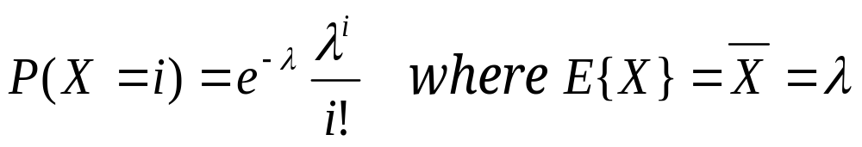
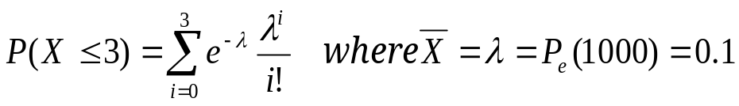
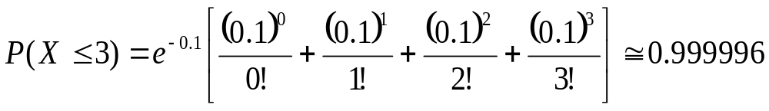

Poisson Distribution
It describes the number of events that occur in an interval of time given that the average rate of occurrence is known.
where λ is the average value of the rate of occurrence of the desired event.
The mean value of the Poisson distribution is λ and the variance is λ.
Example: The probability of error on a single transmission in a digital communication system is P_{e}=10⁻⁴. What is the probability of more than three errors in 1000 transmission?
We find the probability of three errors or less is
Notes:
Queuing theory,

Slide 20
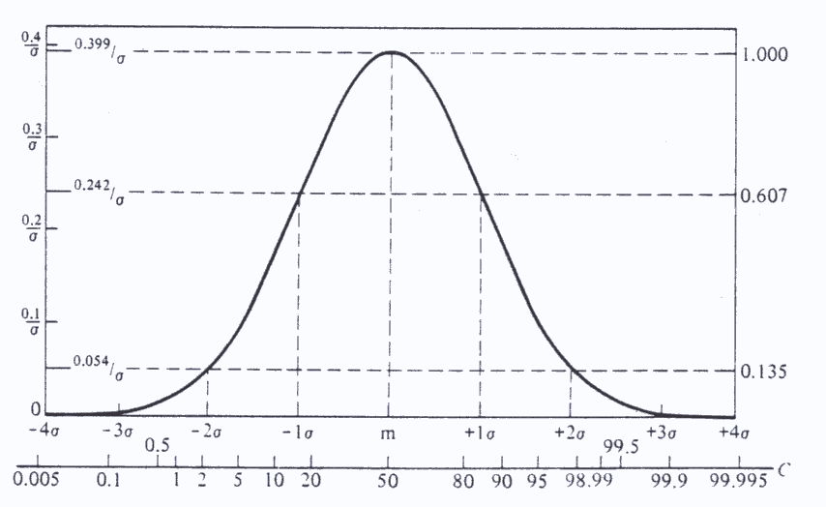
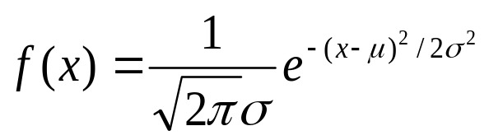
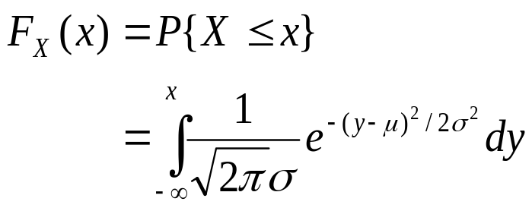
Gaussian Distribution
Central-Limit theorem: The sum of N independent, identically distributed random variables approaches a Gaussian distribution when N is very large.
The Gaussian pdf is continuous and is defined by
where μ is the mean ,
and σ² is the variance .
cumulative distribution function:

Slide 21
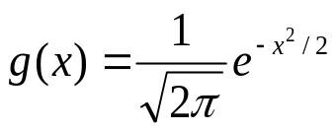
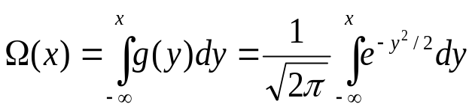
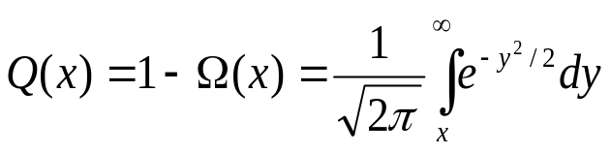
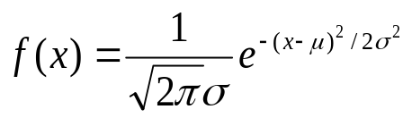
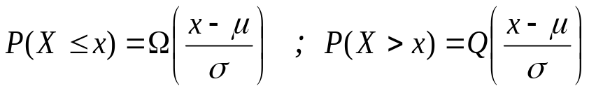
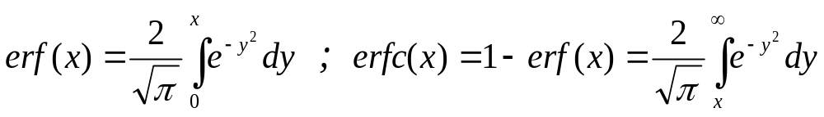
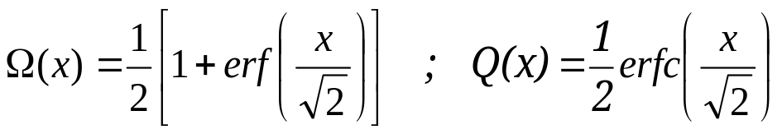
Gaussian Distribution
Zero-mean unit-variance Gaussian random variable:
⇒ Cumulative distribution function:
Define Q-function:
(monotonic decreasing)
In general, for a random variable X with pdf:
Define: error function (erf) and complementary error function (erfc) :
Thus,

Slide 22
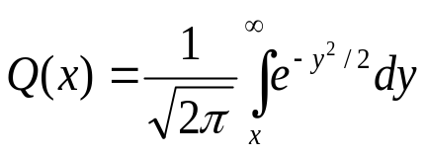
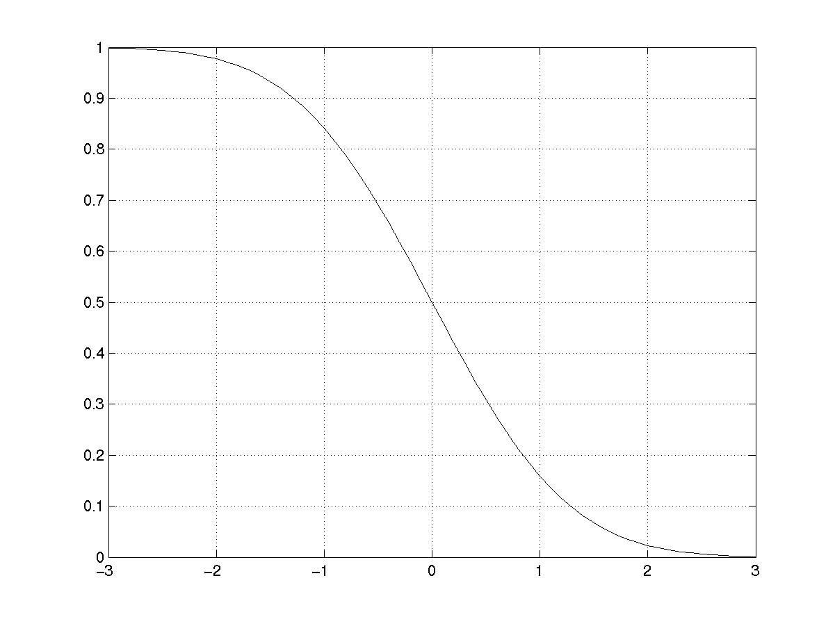
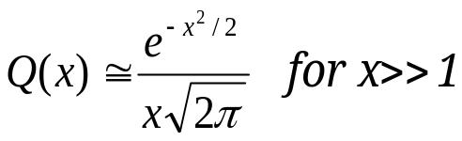
Q-function

